Slide 1

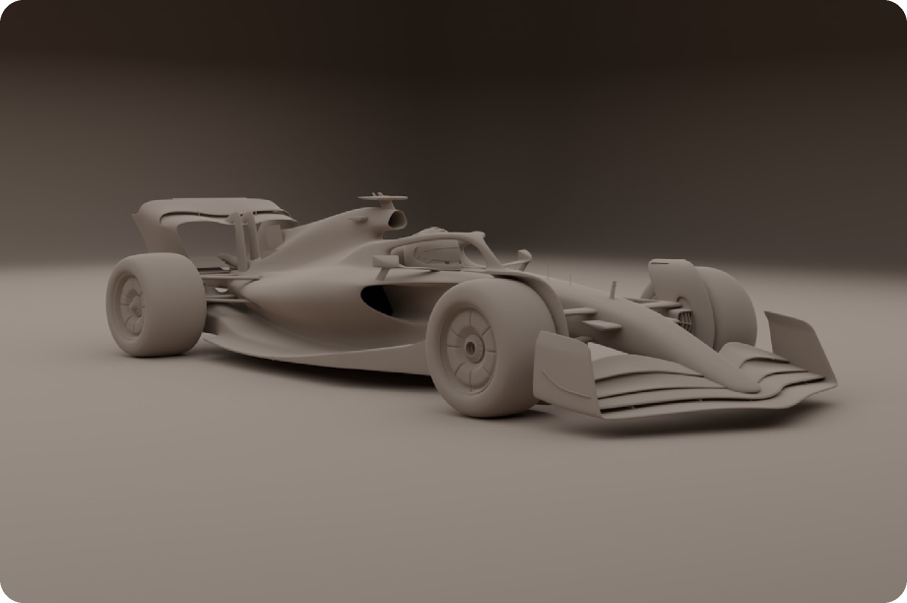
Bhavya Pandya - 09/2025
Formula 1 Innovations in Road Vehicles
Technology Transfer from Track to Street
A Comprehensive Analysis of Motorsport Innovation Adoption in Consumer Automotive Engineering

Slide 2

Research Presentation
2
2 mins.
2 mins.
2 mins.
01
Introduction and Problem Statement
02
Literature Review and Research Gaps
03
Aerodynamics in Racing and Road Cars
Table
of- Content
2 mins.
2 mins.
2 mins.
04
Lightweight Materials and Safety
05
Transmission and Control Systems
Powertrains and Hybrid Efficiency
06
2 mins.
07
Conclusions and Future Directions

Slide 3
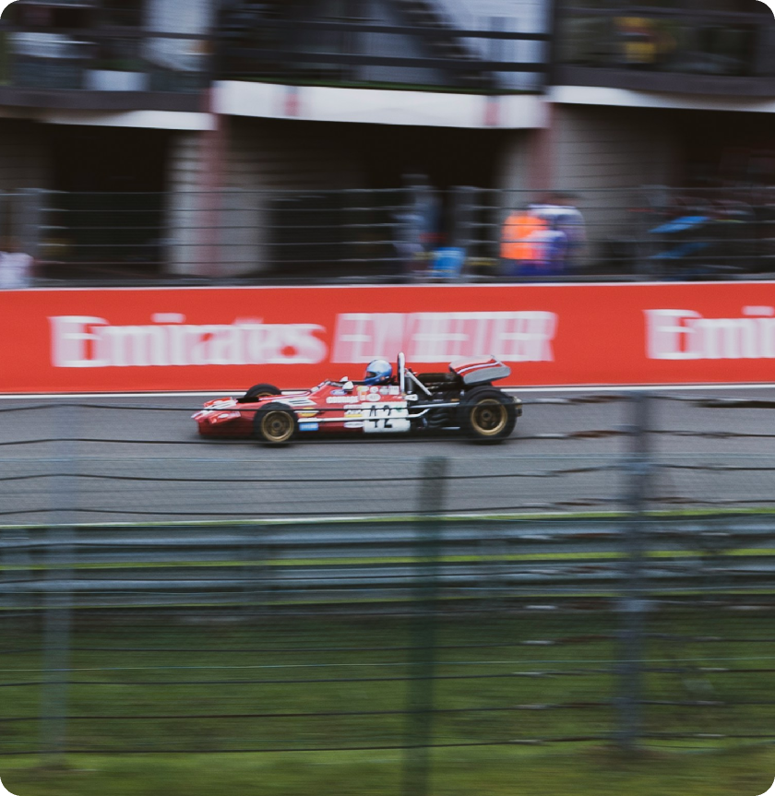
Research Presentation
3
Explanation of the Research
Formula 1 is not only a sport but also an engineering laboratory. Innovations in hybrid engines, gearboxes, composites, and aerodynamics migrate from racetrack to road cars. This study examines how such technologies are transferred and adapted for mass-market use. This research fills important knowledge gaps by addressing the challenges that arise in building and manufacturing F1 cars and then solving the problem of which F1 technologies actually reach consumer cars.

Slide 4
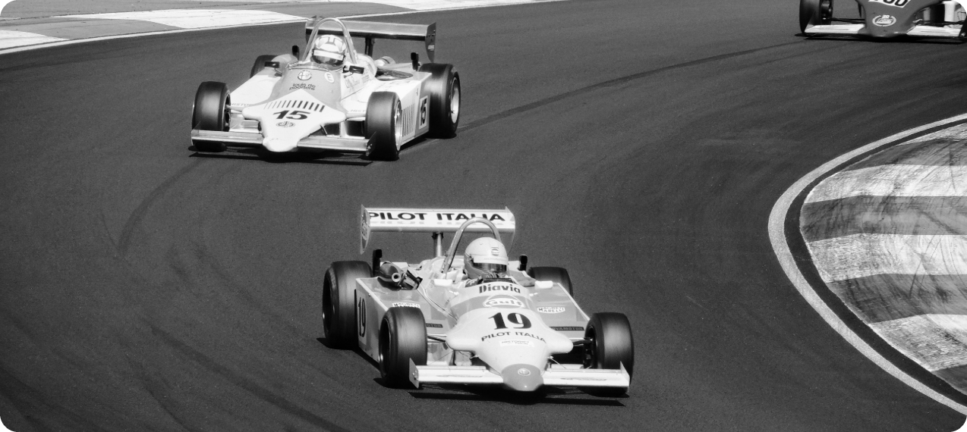
Research Presentation
4
Literature Review and Research Contribution
The literature reveals compelling individual case studies spanning seven decades of innovation.
McLaren's in 1981 as the first to use carbon fiber frames
Ferrari's 1989 to first make paddle-shift gearbox
Lotus 78 (1977) first use of ground-effect aerodynamics.
This study provides the suggesting ways to speed up the adoption of beneficial racing innovations in everyday vehicles.

Slide 5
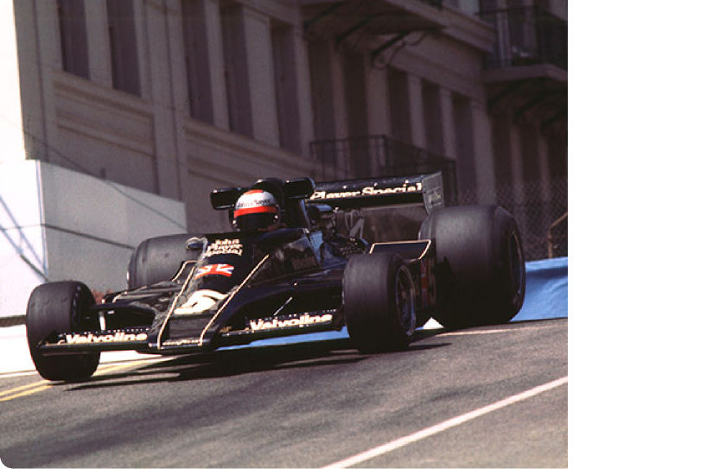
Research Presentation
5
Aerodynamics in Racing and Road
The Lotus 78 in 1977 was the first Formula 1 car to successfully harness ground-effect aerodynamics, using shaped underbodies to generate enormous downforce and transform cornering performance. This breakthrough showed how airflow beneath the car could be as important as airflow above it.
Today, active aerodynamics adjustable wings and flaps are used in hypercars to balance speed and safety, while everyday family cars benefit from simpler innovations like optimized underbodies and active grille shutters that quietly enhance efficiency on daily commutes.

Slide 6
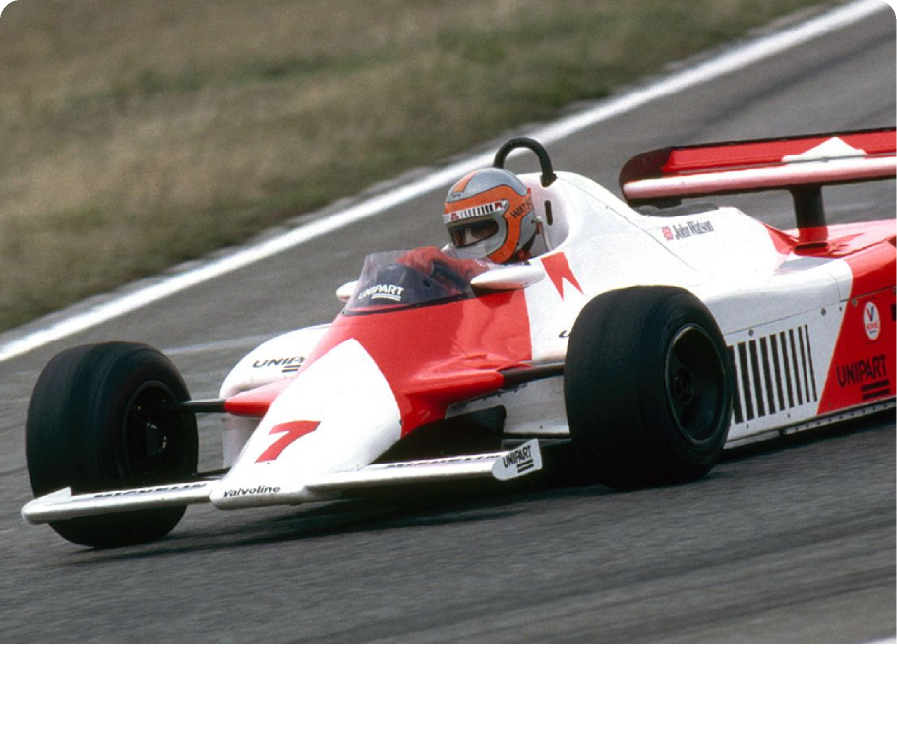
Research Presentation
6
Lightweight Materials and Safety
The McLaren MP4/1 in 1981 was the first F1 car to use a full carbon-fiber chassis, revolutionizing both performance and safety.
Carbon fiber offered an unmatched combination of lightweight strength and superior crash protection, proving its value on the racetrack.
Over time, this innovation spread far beyond F1. Today, carbon fiber is a standard material in supercars and aerospace engineering,

Slide 7
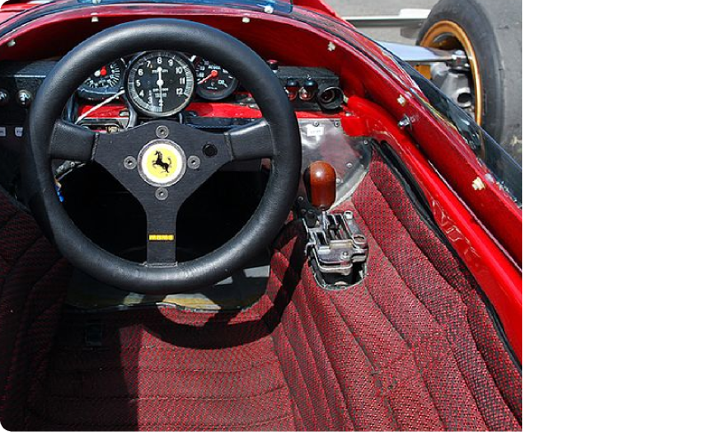
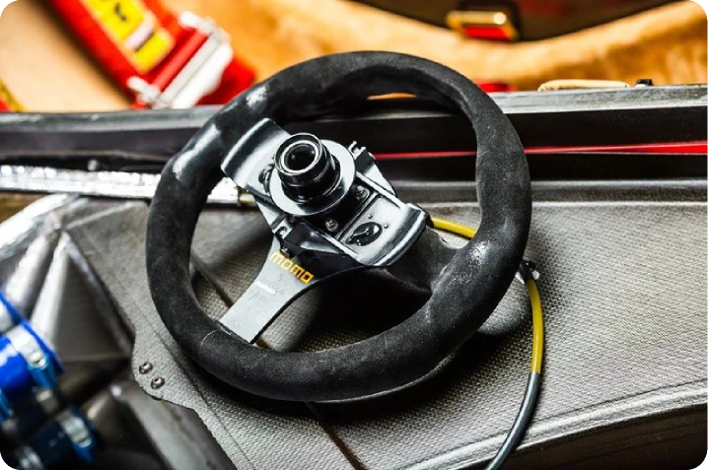
Research Presentation
7
Transmission and Control Systems
The Ferrari 640 in 1989 introduced the world’s first paddle-shift gearbox, allowing drivers to change gears without taking their hands off the wheel. Within just a few years, this breakthrough spread to Ferrari, Lamborghini, Porsche, and eventually to mainstream performance cars.
Beyond sports cars, paddle-shifters are now featured in many family sedans and SUVs, showing how a racing innovation reshaped everyday driving.

Slide 8
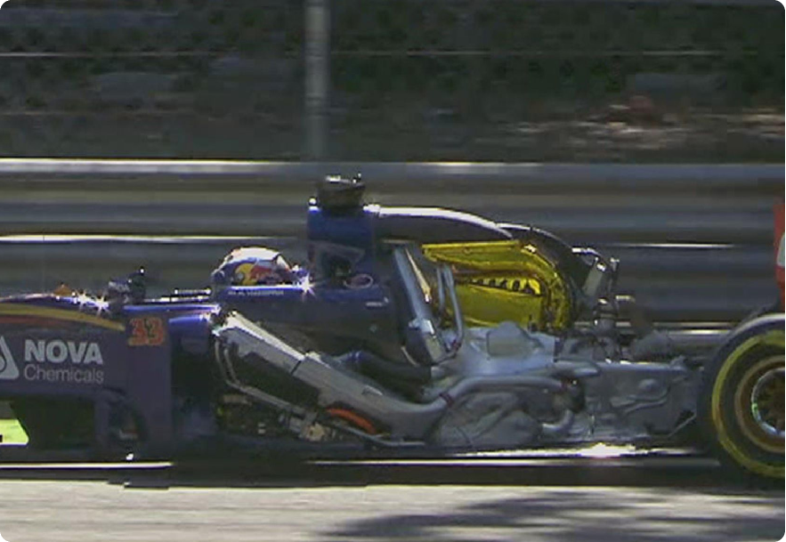
Research Presentation
8
Powertrains and Hybrid Efficiency
The 2014 hybrid era in F1 introduced turbocharged V6 engines combined with advanced energy recovery systems, setting a new benchmark for efficiency and performance. These power units achieved over 50% thermal efficiency an unprecedented figure in internal combustion technology and directly inspired road-going hypercars like the Mercedes-AMG ONE.
Beyond the world of supercars, the engineering lessons from these hybrids particularly in thermal management, battery integration, and turbocharger design are now shaping mainstream hybrid vehicles. From compact hatchbacks to family SUVs

Slide 9
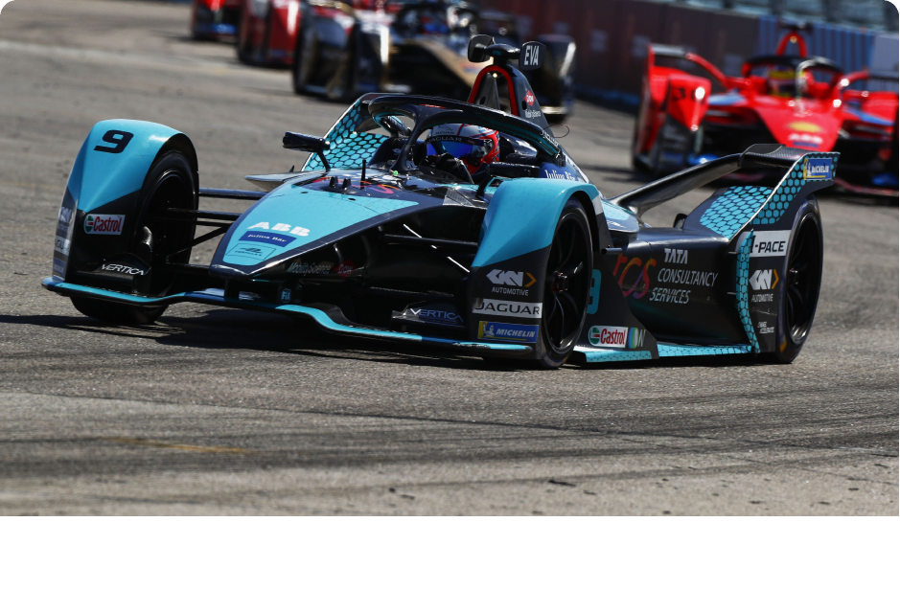
Research Presentation
9
Conclusion and Future Research Directions
Formula 1 is not just racing it is a place where new technology is tested. What starts in F1 often moves first into expensive hypercars and then into normal road cars. This shows how F1 acts as a bridge between extreme innovation and everyday driving.
In the future, F1 is also looking at electric racing, smarter batteries, and AI-powered car data systems. If successful, these ideas could shape how electric cars, self-driving systems, and even city transport will look in the coming years.

Slide 10

Thank You
For Your Time And Attention Today.

Slide 11
